Slide 1
Customer Loyalty App Usability Study
Joseph Austin

Slide 2
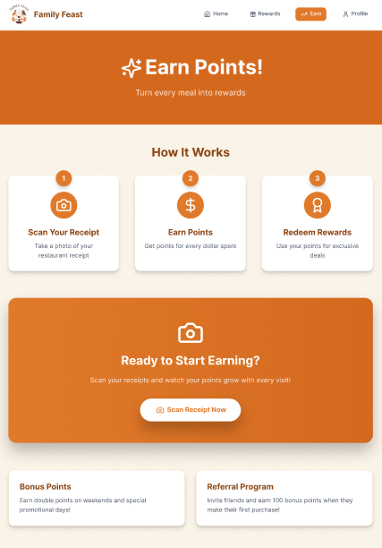
Project overview
The product:
This is a customer loyalty app for a family restaurant. This app is designed to reward customers for their visits and build customer satisfaction.
Project duration:
February 2026 – May 2026

Slide 3
Project overview
The problem:
Not enough customers are feeling valued or appreciated during their visit to restaurants.
The goal:
To build a Customer Loyalty App that offers deals and rewards to show appreciation and also retain customers.

Slide 4
Project overview
My role:
UX Designer, UX Researcher
Responsibilities:
Created Web & App wireframes
Created a research plan
Created App & Web lo-fi prototypes
Created Web & App Mockups

Slide 5
User research
Personas
Problem statements
User journey maps
Understanding
the user

Slide 6
User research: summary
The type of research I conducted was an unmoderated research study. Assumptions I’ve made before the research were that the users will like the simple navigation and visual appearance the app offers. It has changed a little due to the feedback I’ve received, but overall, my assumptions were correct.

Slide 7
User research: pain points
1
2
3
4
Landing page with no value or info
Bottom navbar not visible for every user
“Account” instead of “Settings”
Personal Settings
3/5 participants didn’t like the app, not like the landing page, being the Sign-Up/Sign-In Screen. This info lets me know users want to view the app’s value before deciding if they want to sign up.
3/5 particpants complained about the bottom navbar being “small” and less visible for them. This will be a guide for brainstorming ways to make the navbar visible for every user who uses the app
1 participant who’s in her 50’s didn’t see the settings page being called “Account” as the icon. Hearing this will help me consider how I can make sure every user doesn’t have difficulty finding the homepage.
1 participant thought a name of one of the settings options in the Account tab was excessive. Not every user interprets certain words the same. I will need to find a way to provide clarity for all users

Slide 8
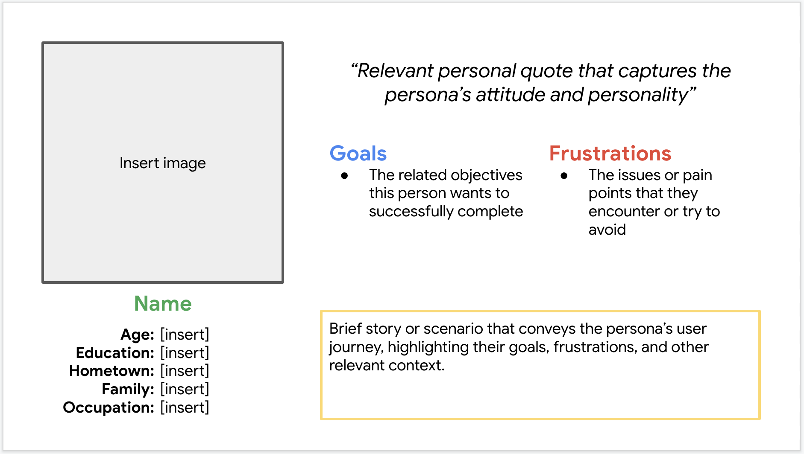
Persona: Name
Problem statement:
[User name] is a [user characteristics]
who needs [user need]
because [insight].

Slide 9
User journey map
[Your notes about goals and thought process]
Image of user journey map

Slide 10
Paper wireframes
Digital wireframes
Low-fidelity prototype
Usability studies
Starting
the design

Slide 11
Paper wireframes
[Your notes about goals and thought process]
Image of paper wireframes including five different versions of the same screen and one image of the new, refined version

Slide 12
Digital wireframes
Description of the element and its benefit to the user
[Your notes about goals and thought process]
Insert first wireframe example that demonstrates design thinking aligned with user research
Description of the element and its benefit to the user

Slide 13
Digital wireframes
Description of the element and its benefit to the user
[Your notes about goals and thought process]
Insert second wireframe example that demonstrates design thinking aligned with user research
Description of the element and its benefit to the user

Slide 14
Low-fidelity prototype
[Link to low-fidelity prototype and brief description of the user flow]
Screenshot of prototype with connections or prototype GIF

Slide 15
Usability study: findings
Write a short introduction to the usability studies you conducted and your findings.
Round 1 findings
Round 2 findings
1
Insert finding
1
Insert finding
2
Insert finding
2
Insert finding
3
Insert finding
3
Insert finding

Slide 16
Refining
the design
Mockups
High-fidelity prototype
Accessibility

Slide 17
Mockups
Before usability study
After usability study
[Your notes about goals and thought process]
Image of selected screen before usability study
Image of selected screen after usability study

Slide 18
Mockups
Before usability study
After usability study
[Your notes about goals and thought process]
Image of selected screen before usability study
Image of selected screen after usability study

Slide 19
Mockups
Main mockup screen for display
Main mockup screen for display
Main mockup screen for display
Main mockup screen for display

Slide 20
High-fidelity prototype
[Link to high-fidelity prototype]
Screenshot of prototype with connections or prototype GIF

Slide 21
Accessibility considerations
1
2
3
Insert one to two sentence summaries describing each accessibility consideration applied in your designs.
Insert one to two sentence summaries describing each accessibility consideration applied in your designs.
Insert one to two sentence summaries describing each accessibility consideration applied in your designs.

Slide 22
Going forward
Takeaways
Next steps

Slide 23
Takeaways
Impact:
Insert one to two sentences summarizing the impact of your designs. In the real world, you’d include data like number of downloads or sign ups, but since this is a course project, you can include a positive quote from a peer or study participant.
What I learned:
Insert a few sentences summarizing what you learned throughout the project.

Slide 24
Next steps
1
2
3
Insert a few sentences summarizing the next steps you would take with this project and why.
Insert a few sentences summarizing the next steps you would take with this project and why.
Insert a few sentences summarizing the next steps you would take with this project and why.

Slide 25
Insert a few sentences summarizing the next steps you would take with this project and why. Feel free to organize next steps in a bullet point list.
Let’s connect!
Insert a brief sentence or two about contacting you and/or reviewing more of your work.
Provide your contact information here. This might include your email address, phone number, and website or link to other professional platforms.

Slide 26
Thank you!

